Slide 1
Social Media for Language Teaching
Dr. Karine Megerdoomian
STARTALK workshop for Teachers of Persian
George Washington University and Georgetown University; June 11, 2012

Slide 2
Outline
Introduction to Social Media
The Persian Social Media environment
Linguistic and cultural content in Social Media
Neologisms
Rhetoric and Ideology
Blogspeak
Tools for search and analysis

Slide 3
Social Media

Slide 4
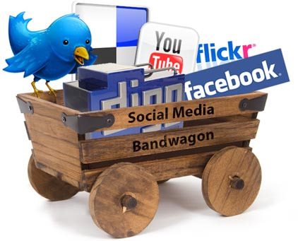
Social Media (رسانه های اجتماعی)
Social media includes the various online technology tools that enable people to communicate easily via the internet to share information and resources.
In this talk:
Wikipedia
Facebook
You Tube
Twitter
Blogs

Slide 5
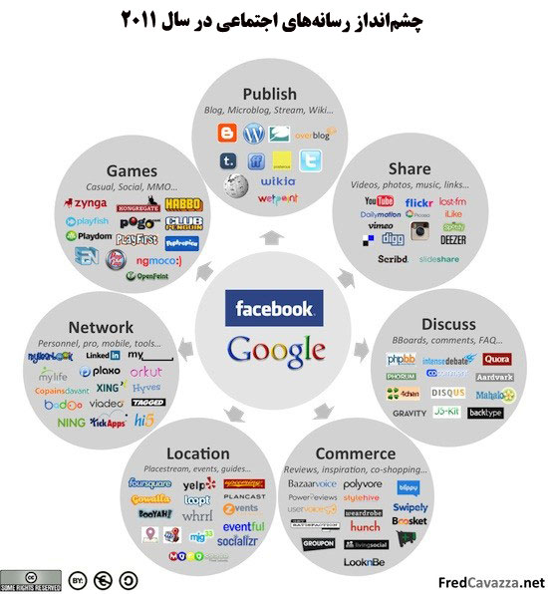

Slide 6
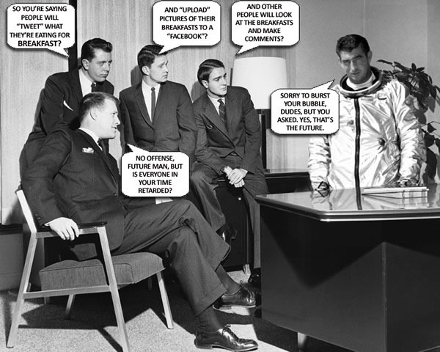

Slide 7
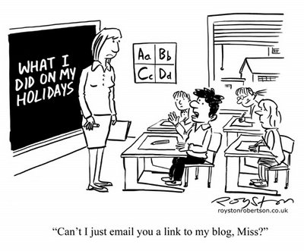
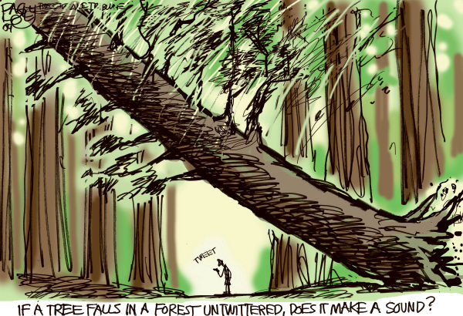
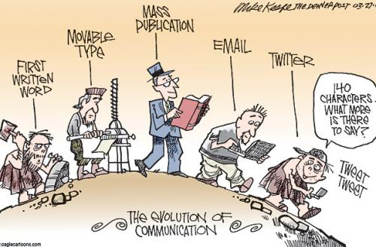

Slide 8
Characteristics of Social Media
Networking without barriers
Allows people to interact and find those with common interests with limited geographic and legal barriers
User-generated content
Anyone with access to the Internet can post his or her own ideas, news, content
Opportunities
Direct and quick access to people’s opinions and experiences
Spoken language is now everywhere!

Slide 9
Social Media in the Classroom
Social Media use vs. Social Media analysis
Authentic learning
Open-ended, student-centered constructivist learning designs where the students try to answer questions by investigating and collaborating, instead of a teacher-centric lecture.
Investigate issues and learn multiple perspectives that will lead to a deeper understanding of the phenomenon.
Authentic contexts and tasks
Environment of total immersion in the language
Understanding of socio-cultural knowledge
Interaction with native speakers

Slide 10
Persian Social Media

Slide 11
Typing Persian
Windows and Mac both allow typing in Persian script
Can use keyboard map to type
Can move between English and Persian script (Alt-shift in Windows)
Can type letters and numbers
Issues
Mixing Right-to-left and Left-to-right directions in the same sentence
Typing Persian numbers in Excel
MS Office on Mac

Slide 12
http://fa.wikipedia.org

Slide 13
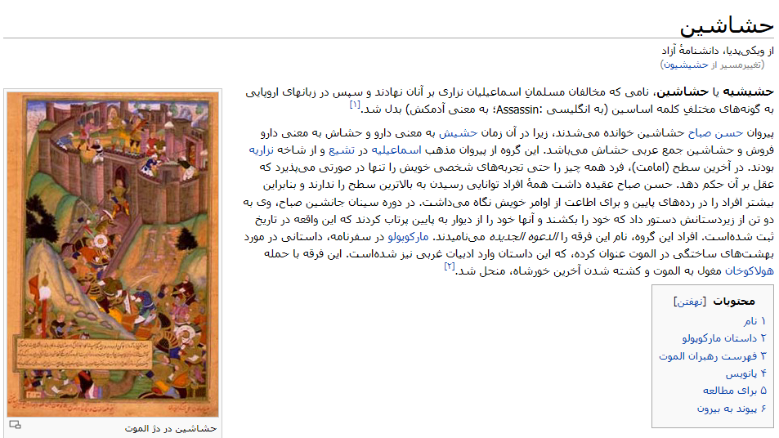
Wikipedia

Slide 14
www.facebook.com

Slide 15
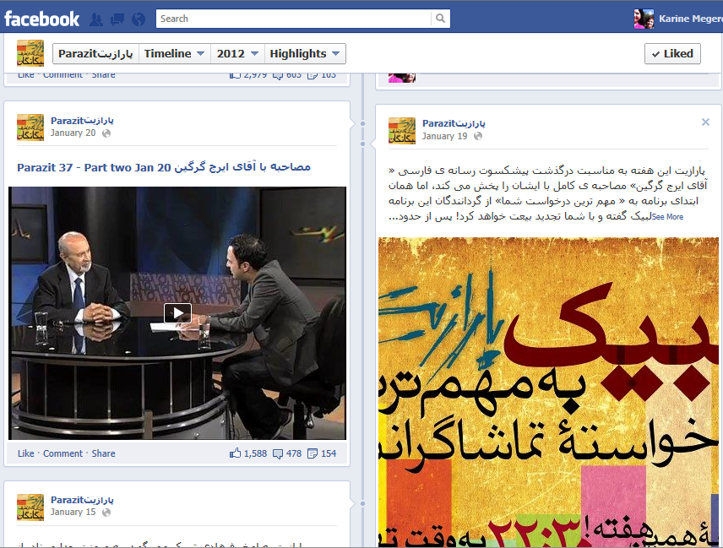

Slide 16
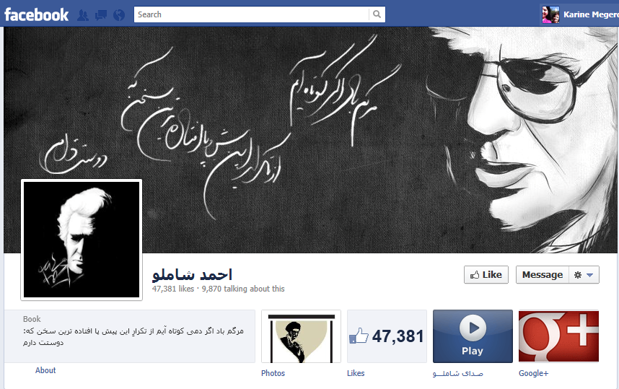

Slide 17
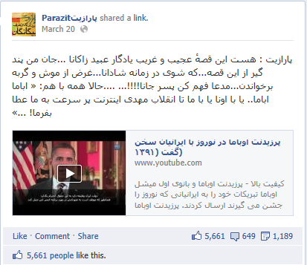
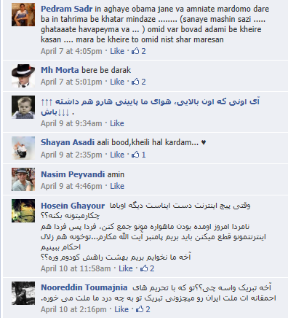
Facebook: Studying Comments

Slide 18
www.youtube.com
یوتیوب

Slide 19
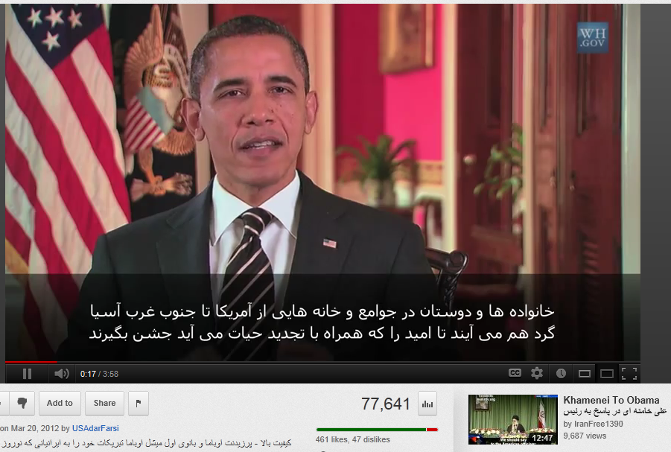
YouTube Videos and Comments

Slide 20
YouTube Videos: Culture

Slide 21
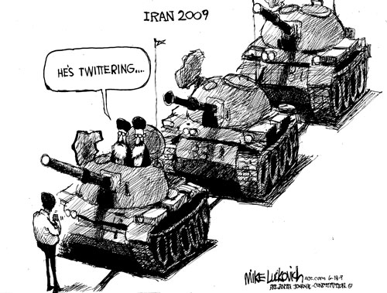
The Twitter Revolution?

Slide 22
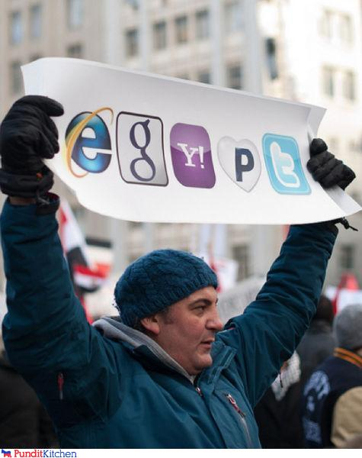
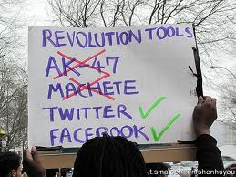
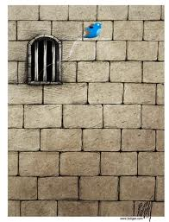
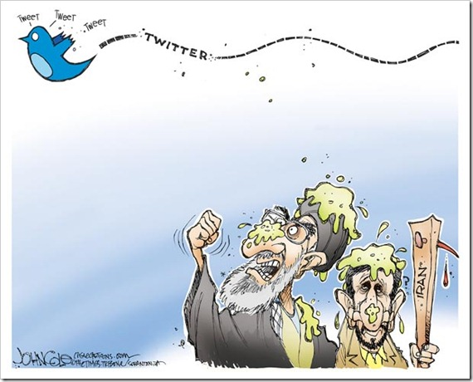
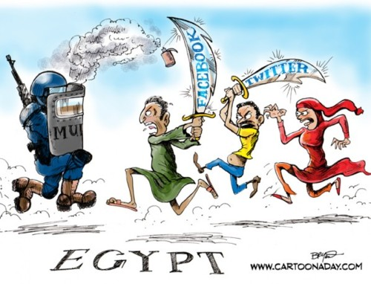
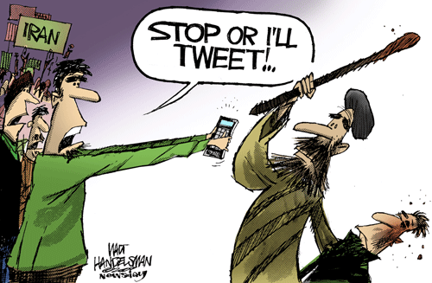

Slide 23
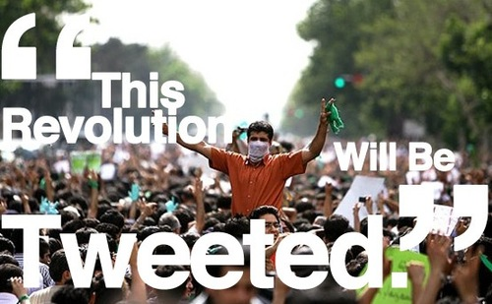
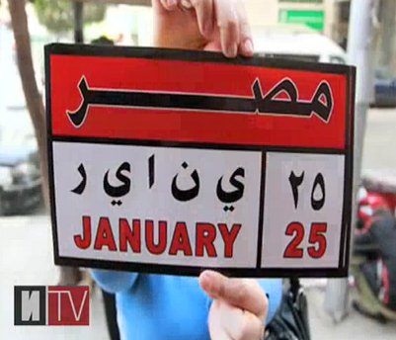
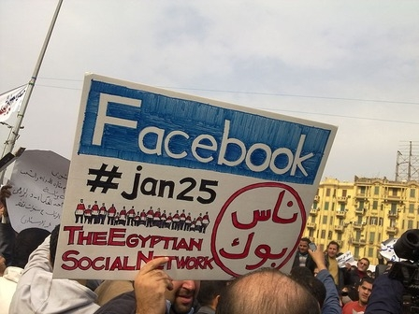
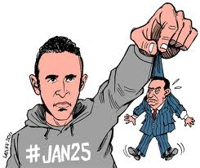

Slide 24
www.twitter.com
توییتر
Twitter allows for fast-paced sharing of information on a topic
# (hashtag) indicates the topic of the thread (e.g., #jan25 for Egypt, #iranelections)
Messages are only 140 characters long
RT means the message was “re-tweeted” or forwarded

Slide 25
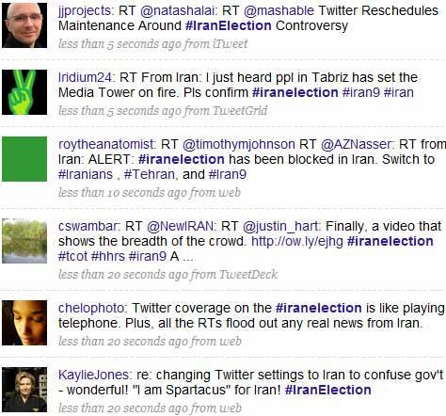
#iranelection sample tweets

Slide 26
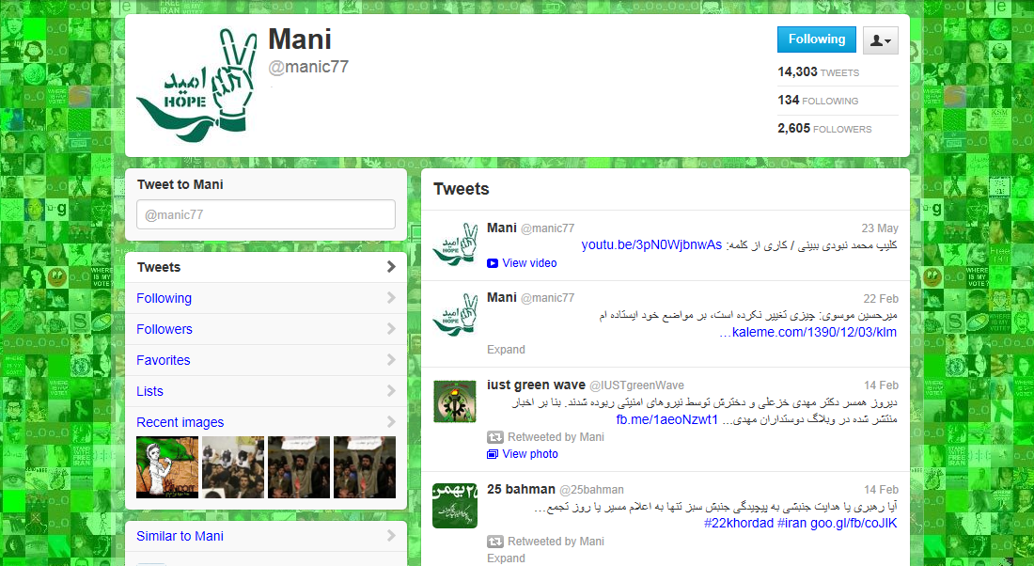
Example of a popular “tweep” or “twitterer” on Iran-related threads

Slide 27
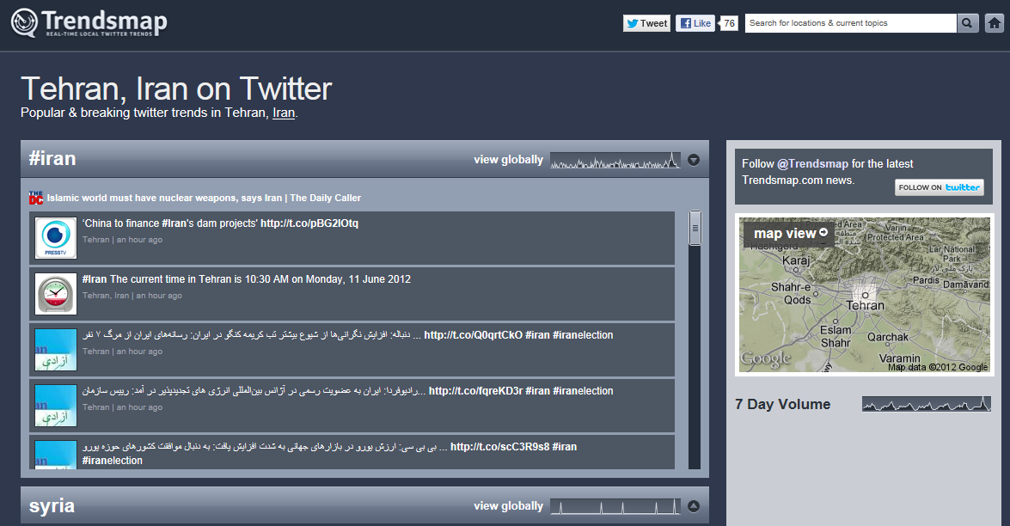
Trendsmap allows you to see what the main topics are in a geographic area

Slide 28
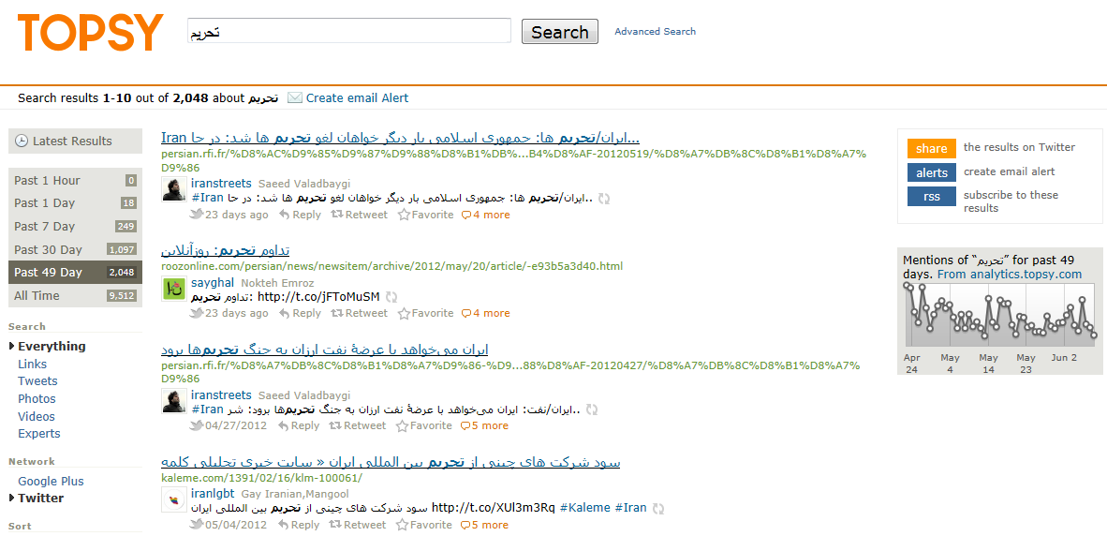
Search for tweets on a specific topic and see the timeline

Slide 29
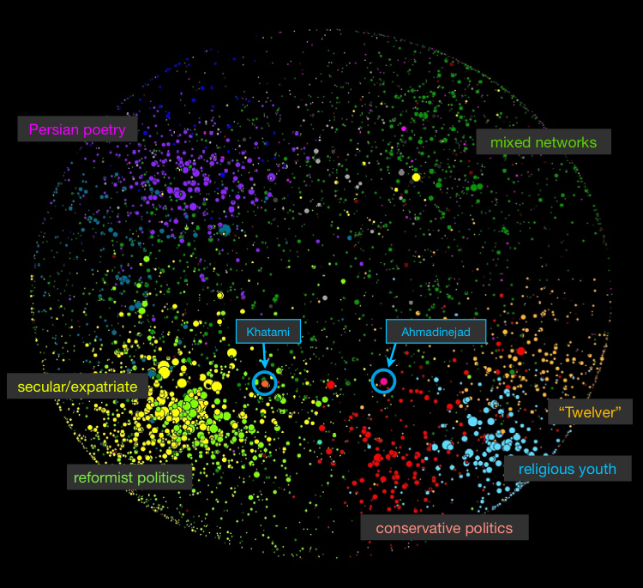
Map of the Iranian Blogosphere
Berkman Center for Internet and Society at Harvard University

Slide 30
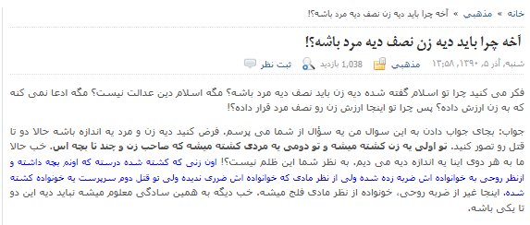
Blog and Forum Discussions

Slide 31
Linguistics and Culture

Slide 32
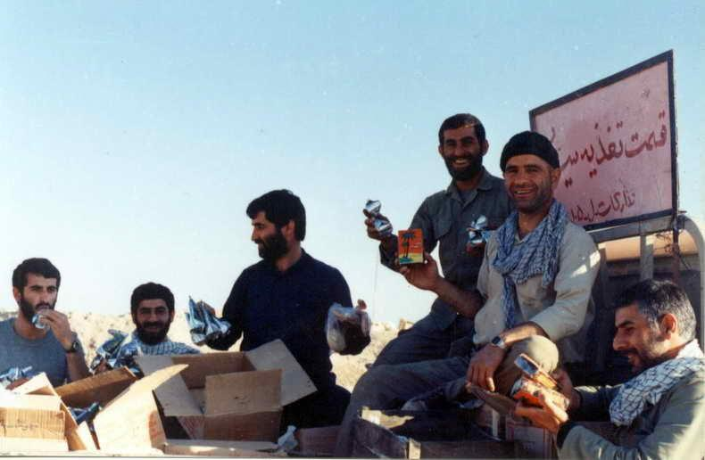
ساندیس‌خوران

Slide 33
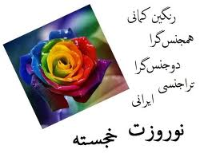
Neologisms: Newly Created Words
راهکار
تلفن همراه
موبایل
نرم افزار
پیامک
بلوتوث
رمز عبور
لاگیدن
دانلود کردن
لینکدونی
کامنت‌گذار
چتیدن
اس‌ام‌اس زدن
فیلترینگشون
وبلاگستان
فتنه‌گر
پیشدستانه
نمایشگر
مونیتور
آوردنمایی
ذوالحقوق
فیلمنامه
تابوسازی
مرورگر
بالگرد

Slide 34
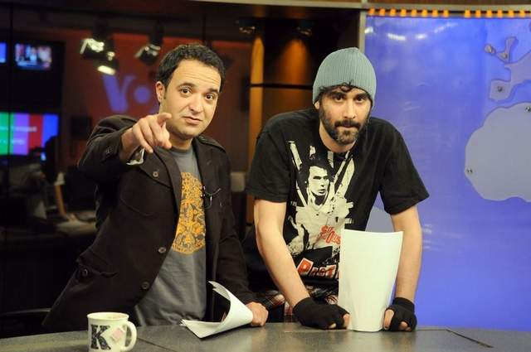
Conversational Language
چرا تونس تونس ما نتونسیم؟

Slide 35
The “Vulgarity Debate” (بحث ابتذال)
Intellectual bloggers criticized the lack of researched opinions in blogs, disregard for standard spelling, and use of conversational language in writing
A clash between two classes of people with unequal access to cultural capital (Alireza Doostdar 2004)
Conversational language in written form, deliberate orthographic and grammatical “mistakes” are a form of resistance against the authority of the intellectuals
December 8, 2003

Slide 36
Diglossia
Diglossia refers to situations where the language spoken by the people in a society differs considerably from the traditional written variant.
The written form which is associated with the literary tradition is considered of higher prestige, whereas the spoken form or vernacular variety of the language is treated as a lower variant
Both variants are equally valid but there is typically a very clear distinction in their functions
Conversational: chatting with friends, buying clothes, meetings
Literary: news reports, literature

Slide 37
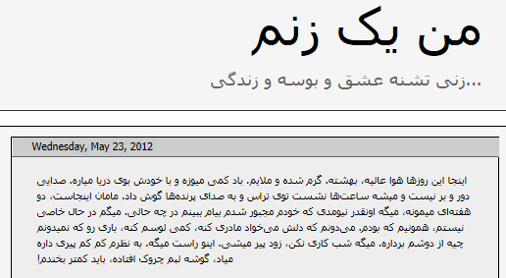
Conversational Language

Slide 38
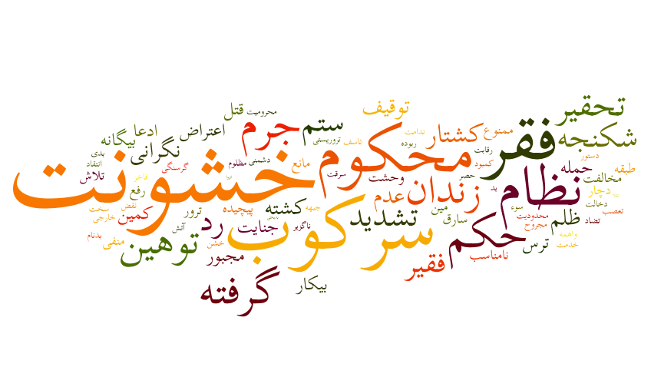
Discovering Themes
Creating word clouds: Frequent words in a document
How to create your own word clouds?
Use wordle.net

Slide 39
Discovering Themes
How to create word clouds?
Go to www.wordle.net and click on Create
Copy a Persian language text (highlight text and press Ctrl+c) and paste onto the top box (click in the box and type Ctrl+v)
Click Go
Randomize changes the color and font
Right-click on a word to delete it from the word cloud

Slide 40
Rhetoric and Ideology
کودتای 22 خرداد
October 26th, 2009
حالا نظام کودتایی ایران با تلفیقی از حرکتهای سلبی و اعتراضی و کارهای ایجابی و ساختاری برای ریشه کنی خود مواجه است و وحشت کرده است. میلیونها ملت به ستوه آمده می خواهند با یک شعار واحد از سلطه این رژیم جائر و فاسد رهایی یابند. مقاومت در برابر این میلیونها معترض، یک خودکشی تمام عیار است که نظام نامشروع آقای خامنه ای را به قهقرا می برد
“Green Movement”
Notes:
Sample text from a reformist blogger in 2009 (during the Green Movement protests)

Slide 41
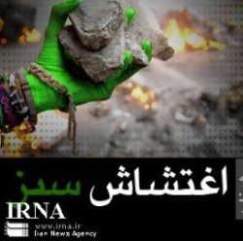
Rhetoric and Ideology
“Green Riots”
Notes:
Sample text from a Basiji blog (Basiji = plain-clothes, paramilitary, pro-government militia) – extreme rhetoric and many metaphors such as the one on top about the hand coming out of the sleeve(!!).
The full sentence on top: “Once again, the hand of oppression and Zionism emerged from under the sleeve of the hypocrite seditioners in order to, in its mistaken belief, pick a flower from the garden of the martyr-developing people of Iran and to take revenge from the people in order to appease its own complexes arising from the big and historical defeat it suffered in Egypt and Tunisia and other Islamic countries.”

Slide 42
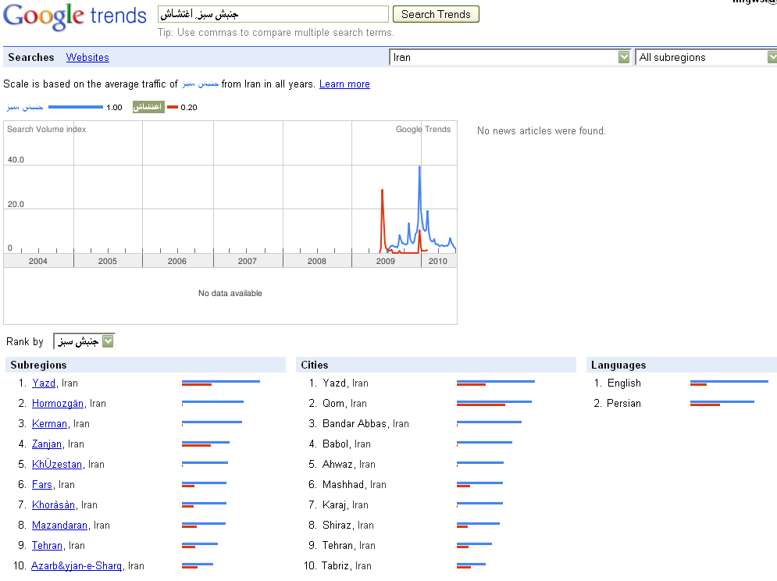
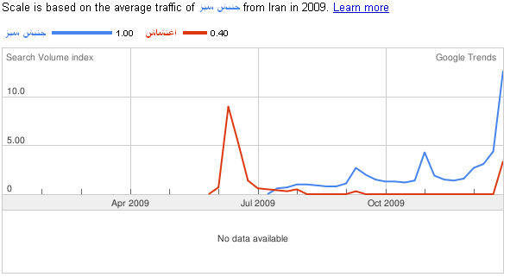

Slide 43
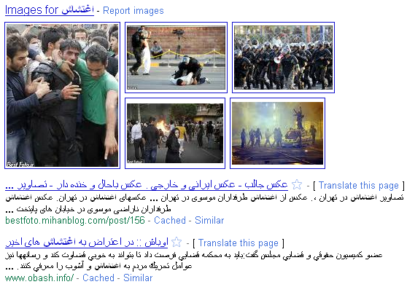

Slide 44
List of Websites Mentioned
Persian Wikipedia: http://fa.wikipedia.org
Facebook: http://www.facebook.com
YouTube: http://www.youtube.com
Twitter: http://www.twitter.com
Blogs: Can search for blogs by using Google
http://www.google.com/blogsearch?hl=en (English)
http://www.google.com/blogsearch?hl=fa (Persian)
Trendsmap: http://trendsmap.com
Topsy: http://topsy.com
Google Trends: http://www.google.com/trends/
Wordle: http://www.wordle.net

Slide 45
مرسی!!
For questions and feedback, please contact karine@mitre.org

