Slide 1
MITRE Infrastructure and Evaluation for Identity Resolution Technology
Keith J. Miller, Elizabeth Schroeder, Sarah McLeod, Azar Ulrich, Karine Megerdoomian, James Finley, Gail Hamilton, Andre Milota, Ken Samuel, Sherri Condon
keith@mitre.org

Slide 2
Overview
Introduction to Entity Resolution
Problem
Solutions
Evaluating ER algorithms
Data
Ground Truth
Metrics
Impact of Research

Slide 3
Introduction
Identity data resides in many locations
Records in different locations can refer to same real-world person
Combining those records provides more comprehensive information about that person
Manually identifying records to be combined is labor-intensive
New information can be discovered by combining records
Notes:
-could include discussion on voice-track about how resolving data/databases could improve screening (

Slide 4
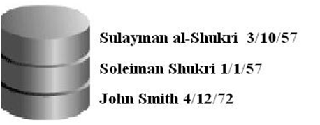
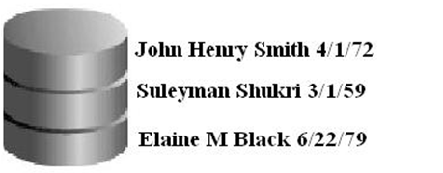
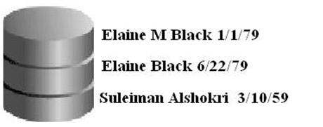
Identities
Entity A
Entity B
Entity C
Notes:
Description: identities in DB, resolved to Entities. * Abstraction of Entities in our model different than ‘real world’ entity since we can’t really know if identities correspond to ‘real world’ entity

Slide 5
Problem Sources
Data Acquisition
Variation in written sources, e.g. Open Source
Data Exchange / Data Quality
Differing data models between systems
Ill-defined or non-existent standards for data exchange
Differing Cultural and Linguistic Conventions Regarding Names
Syntax and morphology
Non-Roman Scripts and Transliteration
Multiple / Redundant Entries
No de-duplication
Information changes
Notes:
How this problem occurs – no deduplication when entering data; misspellings, typos, etc.;

Slide 6
Entity Resolution Strategies
Comparison Strategies:
Pair-wise
Compare two identities at a time
Iterate through entire set of identities
Clustering
Group sets of identities together
Matching Strategies:
Exact matching
Attributes must be identical
Fuzzy matching
Attributes must be similar
Notes:
-need to introduce the vocabulary at some point…perhaps right after the introduction for clarity’s sake
-fuzzy matching – attributes muFIX

Slide 7
Evaluation Requirements
Objective – gives unbiased results
Replicable – gives same results for same inputs
Diagnostic – can give information about system improvement
Cost-efficient – does not require extensive resources to repeat
Understandable – results are meaningful in some way to appropriate people

Slide 8
Evaluation Method
Determine use case
Collect, create, and select test data
Create Ground Truth
Run Entity Resolution algorithms
Calculate metrics for Entity Resolution algorithms
Notes:
-Leverage method from Name Matching evaluation, based on EAGLES-ISLE evaluation framework
Collect test data – need to select data that mimics that variation/noise seen in actual data from the use case (or is the actual use-case data, or subset thereof, etc.)
Ground Truth – depends on the use case; done by humans with assistance of tools like IMAC (adapted for ER); can use pooled results from existing algorithms to produce potential identities/entities to resolve

Slide 9
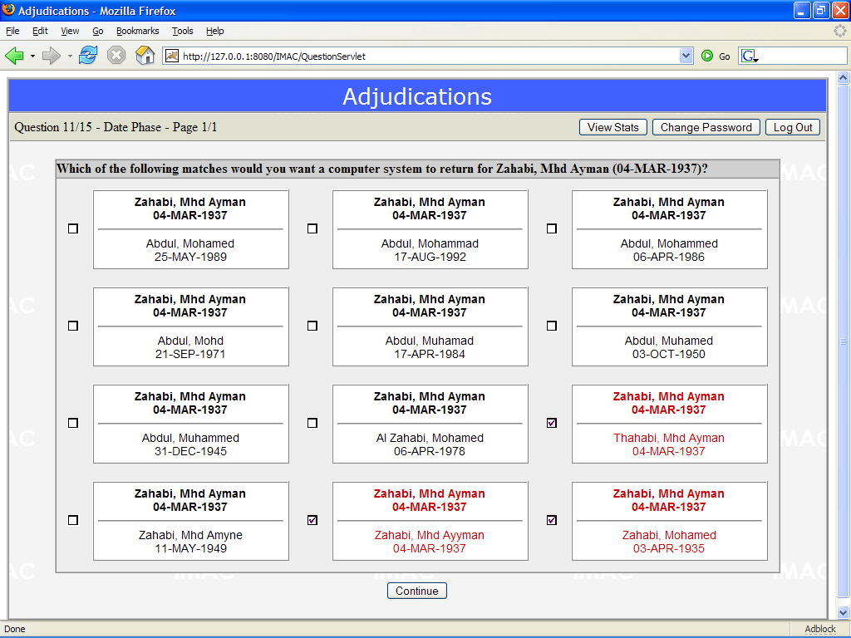
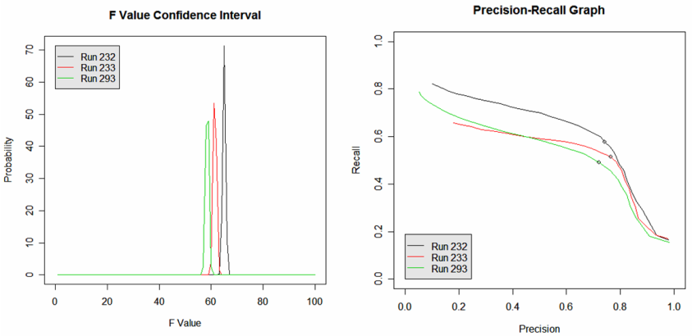
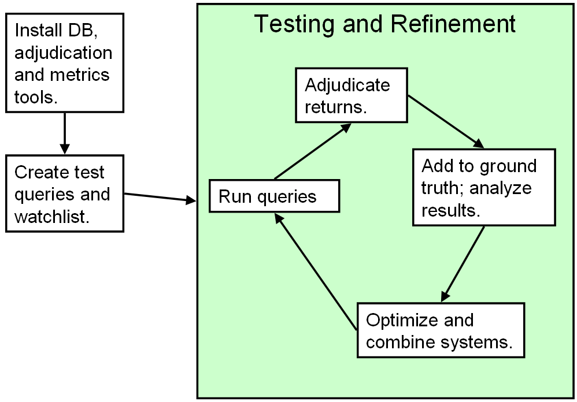
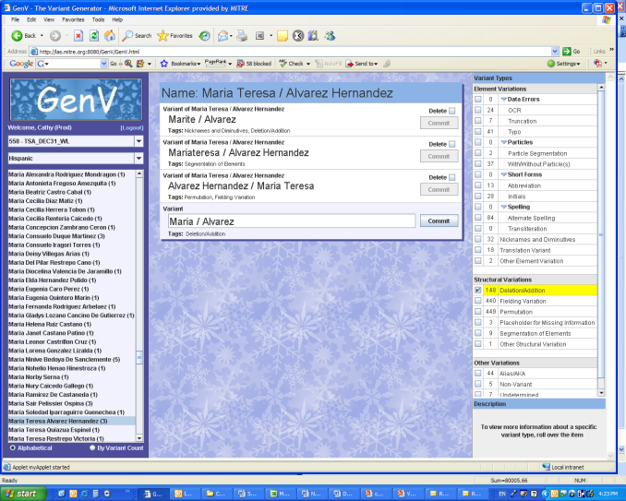
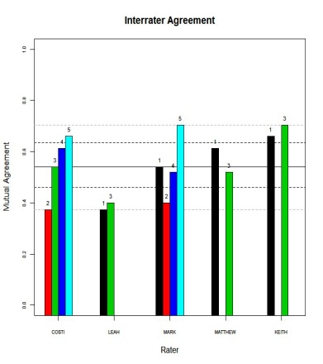
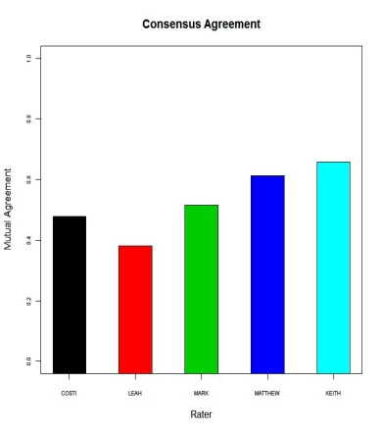
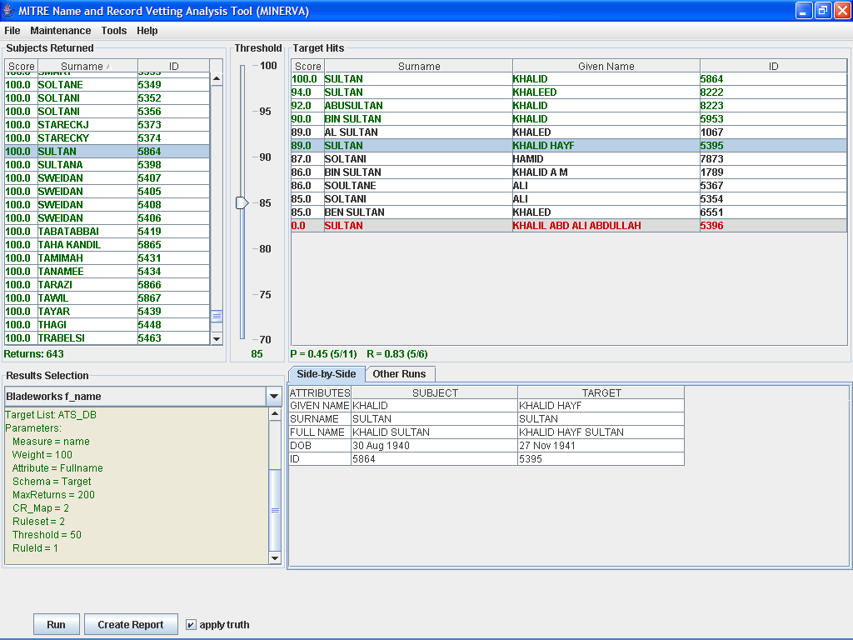
Identity Matching Lab Capabilities
Statistical Results Analysis
Ground Truthing
Experimental Methodology
Ground Truth Quality Control
Test Data Generation and Tagging
Deep-Dive Results Analysis

Slide 10
Use Case
Defines a scenario using entity resolution
Determines evaluation criteria
What data to use
What constitutes “good” resolution
Goal of entity resolution task
Notes:
What type of data to use – e.g. what cultures, what types of variation (noise profile), which attributes, etc.
“Good” resolution – adjudication guidelines vary for the use case (e.g. strict vs. loose, etc.)
Goal of entity resolution – want to find everything vs only want very good resolutions
ADD EXAMPLE

Slide 11
Use Case Example
Scenario
Existing hospital is joining a hospital network
Adding patient database to the network’s database
Similar attributes captured in both databases
Want comprehensive records, but also want to protect patient privacy
Criteria
Don’t resolve unless highly likely
One record can only resolve to one entity
Notes:
Want comprehensive and private - Avoids situation where two records/identities are resolved incorrectly, patients are told comprehensive record (thus revealing another person’s medical record), realizes it’s incorrect and has hospital fix the error

Slide 12
Use Case Example, cont.

Slide 13
Test Data
Range of sources
Different types of variation
Variety of attributes
Can be previously resolved or not
Some human-generated variants
Can create multiple test sets
Notes:
FIX
Want to collect from a range of sources in order to be able to represent different kinds of variation (like those in the taxonomy), see a large range of attributes (even if some of the algorithms don’t utilize them well or not at all); can include entity-identity mappings but doesn’t need to (might not even be used)
-Can create multiple test sets, which means we can create multiple ground truth sets (which we could do anyway, using various use cases and adjudication guidelines)
-”store information about the data” as in metadata about the data (origin, date created, etc.)
-should we refer to it as test data? I guess even if it’s real data we’re still using it to test, so technically…

Slide 14
Data Model
Stores all information regarding evaluation
Test data
Most common attributes stored in tables
New or uncommon attributes all stored in one table
Metadata
Original source of data, types of variants in data, etc.
Results
Information about algorithm, test data used, run results
Ground truth
Information about use case, ground truth
Notes:
-FIX

Slide 15
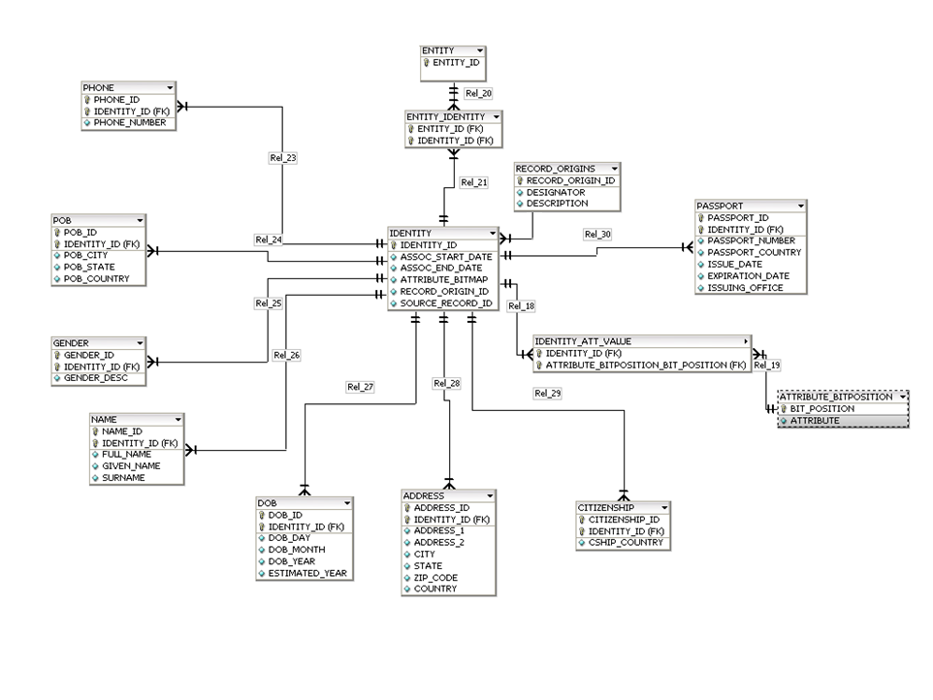
Data Model, cont.
Notes:
-Example of MOIE data model, do display how some data models look; this one is just for person entities, can maintain different attributes, expand for unseen attributes; can be extended to other types of entities
-POB, Phone, etc. tables created based on survey of existing database and most commonly recorded attributes

Slide 16
Ground Truth
Goal output of an entity resolution algorithm
Leverage NIST TREC methodology
Pool results of multiple algorithms
Humans adjudicate algorithm results
Compile judgments into a ground truth set
Specific to a particular use case
Adjudication guidelines based on use case details
Notes:
What constitutes an acceptable match/resolution; can one identity match to multiple entities, multiple identities to multiple entities, etc.? (e.g. multiple people using one driver’s license)

Slide 17
Ground Truth Creation
Test data considerations
Which attributes
What types of variation
Adjudication considerations
How similar must identities be
One entity per identity or many entities per identity
For what time span are attributes valid
All specific to use case
Notes:
How similar must identities be in order to be resolved the same entity? Must the attributes be exact matches, should a certain number of attributes overlap, how similar to names and addresses need to be, etc.?
One-to-many vs many-to-many -> can the resolved entities overlap? Aka disjoint vs non-disjoint ground truth
Time span for attribute validity – could have same address, but years apart – does that matter?
Add a graphic for the one to many, many to many concepts
Identity ~ record (might be useful for audience members who aren’t familiar with this subject area)

Slide 18
Metrics
Be appropriate for task
Produce useful and meaningful results
Investigate metrics from Information Retrieval and Machine Learning
Precision, Recall, F-Measure
For pairwise resolution
Score identity-to-entity mappings
Purity, Inverse Purity
For clustering resolution
Score cluster-to-ground truth mappings
F-Purity, F-Inverse Purity
Combine Precision, Recall, Purity, and Inverse Purity
Notes:
Precision, Recall, F-measure, Accuracy – appropriate for pairwise resolution – say you have an entity composed of identities A B and C in ground truth, but results show A and B. Have to do A to A, B to B, and C to null…can’t take entire entity into account at once
Discuss possible metrics to use – precision, recall, and f-measure from Information Retrieval; metrics for evaluating clustering algorithms (from Machine learning?)
Appropriate for task - purity and fragmentation might not be appropriate for all use cases (esp with pairwise algorithms); purity can be skewed by single-member entities; precision and recall not intended for clustering algorithms
Provide useful results – numbers are intuitive (eg within a certain range like 0 to 1); meaningful - eg Mean Rank, what would it be ranking? the identities to be resolved?
Purity – maps each result cluster to “best” ground truth cluster (cluster combo that produces highest recall), then computes weight average precision over all result-ground truth cluster combos

Slide 19
Privacy
Privacy-enhancing (PE) tools can help protect information and data sources
PE tools might affect entity resolution performance
Can evaluate original and privacy-enhanced versions of algorithms
Measure tradeoff between PE tool performance and entity resolution performance
Notes:
Can measure the impact of privacy-enhancing technology by applying the technology to algorithms used, calculating the metrics for the privacy-enhanced runs, and compare to non-enhanced runs.
Add more about what privacy enhancing is and how it works (?)

Slide 20
Impact
Enable more effective screening at identity level
Provide a methodology that enables government screening and credentialing organizations to know how they are doing
Improve intelligence analysis across databases
Push state of the art by providing qualitative and quantitative feedback to vendors on performance of their tools
Notes:
-improve intelligence analysis by speeding up process, potentially revealing relationships/resolutions that wouldn’t have been found manually, etc.

Slide 21
References
Blume, M., & Kalmar, P. (2008). Methods for Evaluating Entity Disambiguation. Language Resources and Evaluation Conference. Marrakech, Morocco: European Language Resources Association.
Calzolari, N., Zampolli, A., & Lenci, A. (2002). Toward a Standard for a Multilingual Lexical Entry: The EAGLES/ISLE Initiative. In Computational Linguistics and Intelligent Text Processing. Berlin: Springer.
Conrad, J., Custis, T., Dozier, C., Heinze, T., Light, M., & Veeramachaneni, S. (2008). Linking, mapping, and clustering entity records in information-based solutions for business and professional customers. Language Resources and Evaluation Conference. Marrakech, Morocco: European Language Resources Association.
Miller, K., Arehart, M., Ball, C., Polk, J., Rubenstein, A., Samuel, K., et al. (2008). An Infrastructure, Tools, and Methodology for Evaluation of Multicultural Name Matching Systems. Language Resources and Evaluation Conference. Marrakech, Morocco: European Language Resources Association.
Vorhees, E., & Harman, D. (2000). Overview of the Eighth Text REtrieval Conference (TREC-8). Proceedings of the Eighth Text REtrieval Conference (TREC-8). Gaithersburg, MD: National Institute of Standards and Technology.

Slide 22
Backup

Slide 23
Ground Truth Creation, cont.
Disjoint Ground Truth
Non-Disjoint Ground Truth
Identity A
Identity A
Identity B
Entity 1
Identity B
Entity 1
Identity C
Identity C
Identity D
Entity 2
Identity D
Entity 2
Identity E
Identity E
Identity F
Entity 3
Identity F
Entity 3

