Slide 1
Linguistic Competence of Persian Heritage versus Second Language Speakers
“Routledge Handbook of Second Language Acquisition and Pedagogy of Persian” Book Launch
McGill University • January 15, 2021
Dr. Karine Megerdoomian MITRE karine@mitre.org

Slide 2
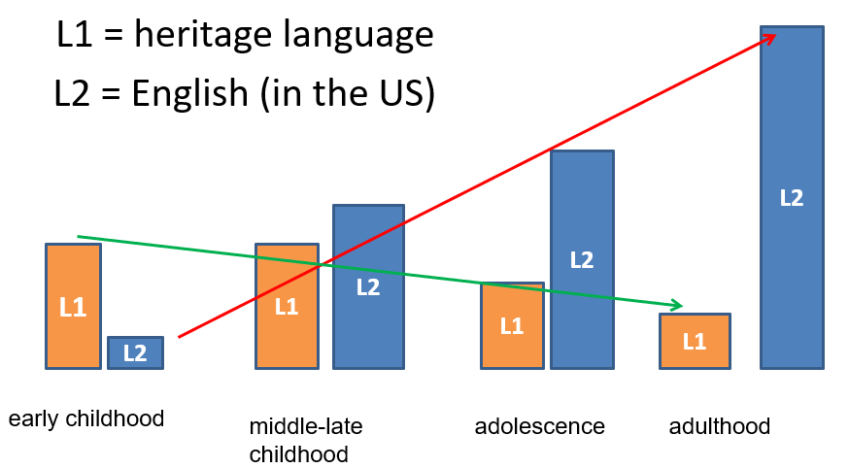
Heritage Speakers vs. L2 Learners
Heritage Speakers are unbalanced bilinguals
Heritage Language (HL) is their first language (L1) = minority language
More proficient in the dominant language of the society
Large variance in the population (from near-native to those who only understand but don’t speak HL)
Chart courtesy of Sylvia Montrul

Slide 3
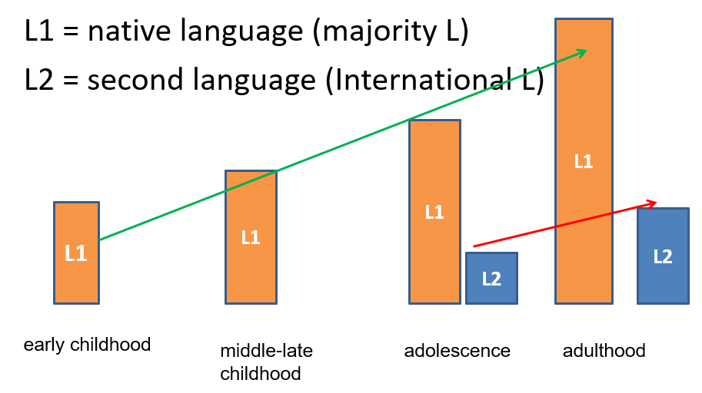
Heritage Speakers vs. L2 Learners
Second Language (L2) Learners: Encounter the language later in life, typically in a classroom
Native Speaker (NS): Has attained relatively complete acquisition of the native or L1 language
Chart courtesy of Sylvia Montrul

Slide 4
PART I: Theory-Driven Research on Second Language Acquisition of Persian
Overview of prior work on the phonology, morphology, syntax, semantics and discourse of Persian among second language (L2), Heritage (HS), and monolingual native (NS) speakers
Identify similarities and differences in the processing and acquisition of grammatical patterns of Persian among these speakers
Present the experimental results within the theoretical framework of Language Acquisition in these different groups
Discuss how research findings can inform teaching methodology used in the classroom

Slide 5
PART I Highlights
Reza Falahati presents research on acquisition of L2 phonology and presents results of an experiment showing how Persian L2 and NS speakers use different prosodic strategies to express the appropriate level of formality register (Chapter 2)
Yasaman Rafat provides an overview of theoretical approaches to Heritage and L2 speech and argues for a multimodal approach that considers the role of orthography in phonological acquisition (Chapter 3)
Azita Taleghani focuses on acquisition of negation in progressive tenses in HS, L2, NS and finds evidence to support the Incomplete Acquisition hypothesis (Chapter 5)
Ex. Sārā dāre tu otāghesh dars ne-mi-khun-e (acceptable by HS)

Slide 6
PART I Highlights (cont.)
Pouneh Shabani-Jadidi investigates the processing, comprehension, and acquisition of idiomatic expressions in L2 and shows how the experimental results can guide development of teaching strategies (Chapter 6)
del be daryā zadan [heart to see hit] ‘to take a risk’
Masoud Jasbi discusses semantic complexities of certain functional elements in Persian –like ye, hā, ro – which give rise to different meanings in different contexts (Chapter 7)
Marzieh Mortazavinia compares the acquisition of ham and hattā in focus contexts among L2 and NS population (Chapter 8)
Ex. hattā amir ham umade bud

Slide 7
Goal of this Talk
Focus on experimental methods for study of Persian heritage language and Persian L2 in phonetics, phonology, morphology, syntax
Provide an understanding of the differences between L2 speakers and Heritage Speakers, and point to the impact on teaching methodology and curriculum development
The “baseline” for comparison: The Native Speaker (standard variety of homeland), conversational variant
Findings
HS proficiency: Phonology (better than L2) > Morphology > Syntax
L2 perform better than HS in elements that are part of written/formal language
HS are more prone to interference effects from the dominant language

Slide 8
Heritage Language Research
Heritage languages are characterized by a coherent grammar
Can describe HL characteristics in a systematic manner
Heritage languages across language groups share similar characteristics
The linguistic characteristics of heritage speakers are distinct from those of the native speaker (monolingual or balanced bilingual) and the L2 learner

Slide 9
Phonetics
HS (low) = L2
Errors in perception of sound contrasts that don’t exist in dominant language
/G/ (gh) → /g/ by HL and L2
/x/ (kh) → /k/ by HL and L2 (ex. /bebakšid/ instead of /bebaxšid/ ‘excuse me’)
May be sensitive to position of phoneme within the syllable (easier in beginning of syllable)
Variation in HL with some at near-native results
Standard Orthography |  |  | Heritage/L2 Orthography
قشنگ | /Gašaŋ/ | pretty | گشنگ | /gašaŋ/
بشقاب | /bošGāb/ | plate | بشگاب | /bošgāb/
رعدوبرق | /raɁd-o-barG/ | thunder | رعدوبرگ | /raɁd-o-barg/
قبلا | /Gablan/ | previously | گبلا | /gablan/
Notes:
voiced uvular stop/fricative allophone /G/ (gh) → the velar voiced stop /g/ by HL and L2
Velar voiceless fricative /x/ (kh) → the velar voiceless stop /k/ by HL and L2 (ex. /bebakšid/ instead of /bebaxšid/ ‘excuse me, forgive’)

Slide 10
Phonology
HS > L2
Heritage Speakers have internalized many phonological alternations (see Bijankhan 2018)
Phonological pattern | Standard Orthography |  |  | Heritage Orthography
Nasal place assimilation | شنبه | [šanbe] | saturday | شمبه | /šambe/
Devoicing | اقتصاد | [eGtesād] | economy | اختصاد | /extesād/
Devoicing | اسب | [asb] | horse | اسپ | /asp/
Deaspiration | رفتم | [raftam] | previously | رفدم | /rafdam/
Glottal deletion | شعر | [šeɁr] | poem | شر | /še:r/
Stop deletion | دوست داشتم | [dust dāštam] | (I) liked | دوس داشتم | /dus dāštam/

Slide 11
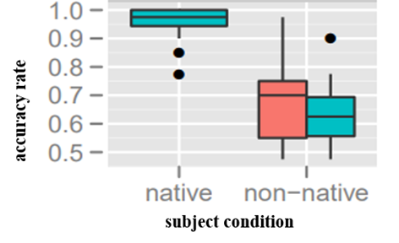
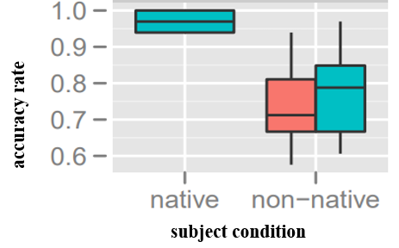
Lexical Negation
HS = L2
Agentive Nouns
Plural Formation
/nā-rāhat/ (uncomfortable) /bi-arzeš/ (worthless) /zedd-e-zarbe/ (anti-shock) /na-tars/ (fearless) */bi-me:rabun/ (→ unkind) */nā-tarbiyat/ (→ impolite) */Geyr-e-dorost/ (→ incorrect)
/po:sči/ (mailman) /jenāyatkār/ (criminal) /kārgar/ (worker) /estebdādgar/ (despot) */ketābči/ (→ bookseller) */čubkār/ (→ carpenter) */sabadgar/ (→ basket-maker)
/kudakān/ (children) /kalamāt/ (words) /mottexasesin/ (experts) /enGelābiyun/ (revolutionaries) */anjomanān/ (→ associations) */towzihin/ (→ explanations) */panājer/ (→ windows)
Native
Heritage
L2
Derivational Morphology

Slide 12
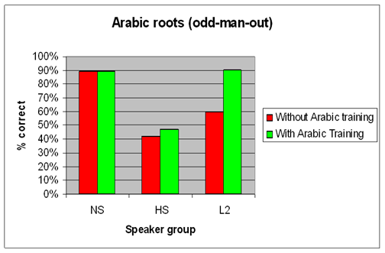
Arabic Plurals
HS < L2
Root form | Prompt 1 | Prompt 2 | Distracter | Outsider
شعر š-Ɂ-r | شاعر šāɁer ‘poet’ | مشاعره mošāɁere ‘poetry reading’ | شعور šoɁur ‘intelligence’ | معاشرت moɁāšerat ‘associating (with s.o.)’
خرج x-r-j | اخراج exrāj ‘excise, expulsion’ | خروج xoruj ‘exit’ | مخرج maxraj ‘denominator, outlet’ | خجالت xejālat ‘shame, embarrassment’
Derivational Morphology

Slide 13
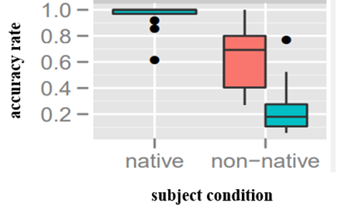
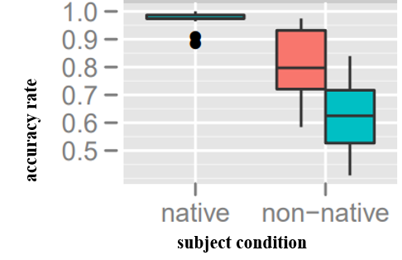
Classifier Choice
HS > L2
Causative Formation
سه تا میوه three CL fruit (three fruits)
دو جلد کتاب two CL book (two books)
/tarsidan/ (fear) → /tarsāndan/ (frighten) /xošk šodan/ (dry) → /xošk kardan/ (dry- caus)
Morphosyntax

Slide 14
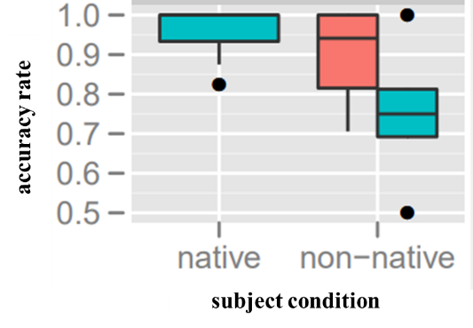
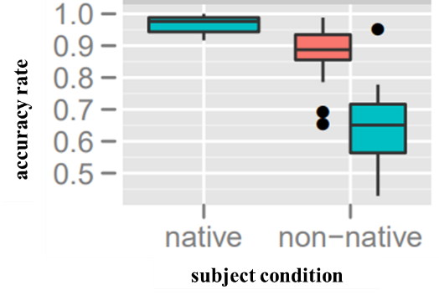
Negative Polarity Relations
Sequence of Tenses
HS > L2
Persian test item | English translation
می‌گه زندگیش سخت می‌گذره. | S/he says her life is hard
گزارش دادن خرسی که دیروز به مزرعه اومده بود، رفته. | They reported that the bear that had come to the farm yesterday has left
*وقتی به دانشگا بریم، لباس رسمی پوشیدیم. | *When we go to the university, we wore formal (official) dress
*تو رستوران منتظر شدیم تا مامان می‌رسید. | *We waited in the restaurant until mom was arriving
/hičči beheš na-gofte budam/ ‘I hadn’t told her anything’
*/hiškas dar-e xuna-ro bāz karde/ ‘Nobody has opened the door to the house’
Syntax

Slide 15
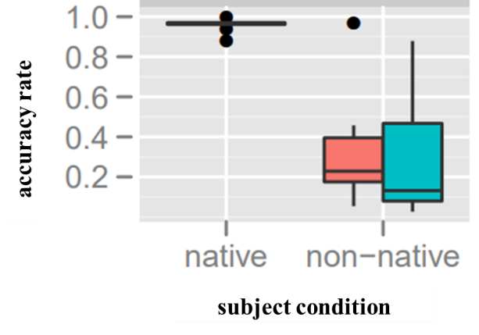
Preposition Choice
HS = L2
Persian prompt
dustāye afGānemun če xub [beep] mā pazirāyi kardan How well our Afghan friends hosted [x] us!
enšātuno [beep] ingilisi benevisin Write your essay [in] English.
to dāri [beep] mohabate man suɁestefāde mikoni You are taking advantage [of] my affection
kešvarhāye orupāyi am [beep] in namāyešgā šerkat mikonan The European nations will also be participating [in] this exhibition
Syntax

Slide 16
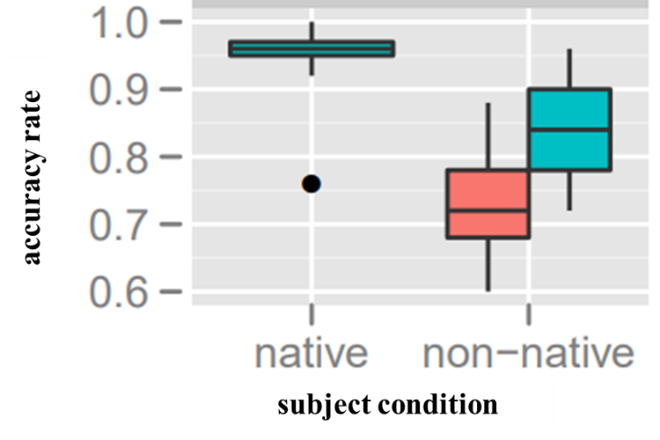
Conjunction Choice
HS < L2
Examples | Persian term
I was out walking when I saw a black cat under the olive tree. | که /ke/ ‘that’
I won't buy you the bicycle I promised unless you get better grades. | مگر این که /magar inke/ ‘unless’
I want to know if you've read this book. | آیا /āyā/
As long as you're in love with this man, you won't consider anyone else. | تا /tā/ ‘until’
Syntax

Slide 17
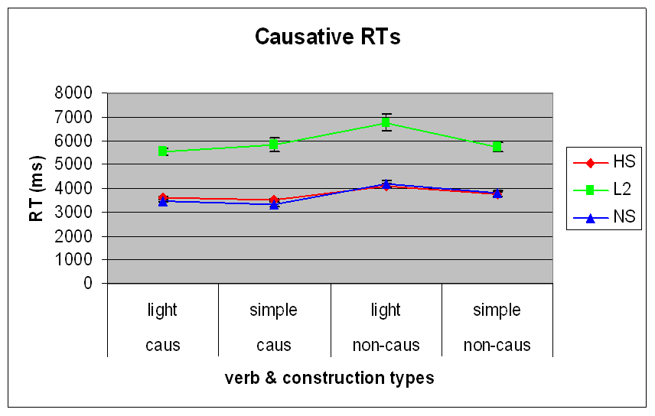
Response Time
HS > L2
HS are as fast as native speakers in making judgements or responding to tasks
L2 learners are slower

Slide 18
Summary
HS have the most obvious advantage in phonetics and phonology
In morphosyntax, results depend on the frequency (salience) of the feature in conversational language as well as the proficiency level of the HS
L2 learners tend to do better than HS
HS do not perform as well as NS on recognition and production of syntactic patterns but tend to do better than L2 (e.g., agreement relations, argument structure, tense dependencies)
HS are more susceptible to interference effects from English ➔ L2 perform better than HS on selection of certain functional elements (e.g., subcategorized prepositions, conjunctions)
HS response time is very close to that of NS across the board

Slide 19
Discussion: Past HL Research
✓ Frequency: more common forms in input language are acquired first by HS
✓ Perceptual salience: forms that are visible in the input language (overtly pronounced or high in the linguistic structure like tense) are successfully acquired in HL ➔ Increased use of resumptive pronouns in HL
✓ Regularization: simplification of language patterns by regularizing one form (the most salient one) over others (e.g., hā for plurals)
✓ Overregularization: use of regular grammatical patterns in a new context (extension of kardan for verb formation different from the forms employed by NS) ➔ /*nejāt kardan/ (rescue make) ‘to rescue’
✓ Compositionality: preference for linguistic patterns that are compositional, providing a more direct form-meaning mapping ➔ HS perform better on causatives with light verbs than with morphemes; HS have difficulty with Arabic root and pattern morphology; HS have low knowledge of idioms, collocations
✗ Distant dependencies: No evidence of difficulty (e.g., subject-verb agreement, negative polarity relations, tense dependencies in complex clauses)
✓ Transfer from dominant language: Strong factor in Persian HL more than in L2 (e.g., preposition selection, conjunction choice)

Slide 20
Studies in Persian HL and L2
Bemani Naeini (2016): Plural formation in English L2 learners of Persian
Cagri, Jackson and Megerdoomian (2007): experimental series of tests on various features
Eslami, Estaji and Elyasi (2014): phonetic perception in Russian L2 learners of Persian
Ghadessy (1998): production of phonemes in English L2 learners of Persian
Khanzadi (2013): phonemic production in English L2 learners of Persian
Moore and Sadegholvad (2013): HL learners’ errors in the classroom
Rafat, Mohaghegh and Stevenson (2017): phonological attrition study
Sedighi (2010): data collected from questionnaires, recorded speech and classroom setting
Shabani-Jadidi (2018): error analysis in advanced Persian classroom

Slide 21
Backup Slides

Slide 22
Phonetics and Phonology
HL speakers perform better than L2 learners in both perception of sound contrasts and production of phonemes
Exists more variation and loss in non-segmental phonology (e.g., intonation, stress, speed of speaking) which tend to contribute to the heritage accent, especially with lower proficiency speakers.

Slide 23
Morphology
HS show an advantage (almost native-like results) over L2 in knowledge of morphological features and verbal paradigms
L2 learners with high proficiency perform similarly to HS on these tasks
HS do not have knowledge of morphological features that are infrequent in the input (conversational) language

Slide 24
Syntax
HS have attained near native competence in some features
Negative polarity items, sequence of tenses, use of subjunctive
L2 learners outperform HS in several domains due to interference effects from dominant language
Preposition subcategorization, conjunction choice in complex sentences

Slide 25
Stress Pattern
HS > L2
Formal variant
Simple past خوردم /xordam/ ‘I ate’
Indicative present perfect خورده‌ام /xordeam/ ‘I have eaten’
Conversational forms are same with only a stress difference
Simple past /xórdam/ ‘I ate’
Indicative present perfect /xordám/ ‘I have eaten’
Heritage orthography represents the conversational pronunciation (خوردم) but HS typically distinguish the pronunciation of tenses

Slide 26
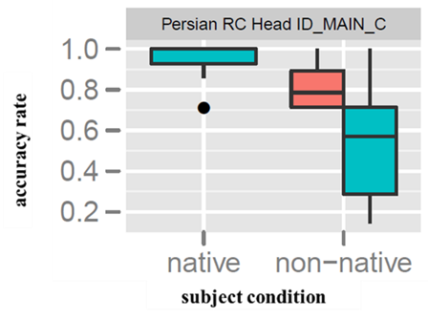
Relative Clauses
HS > L2
Persian test item | Transcription | English translation | Condition
معلمی که شاگردو نگا می‌کنه | moalemi ke šāgerdo negā mikone | The teacher who is looking at the student | Subject gap
پلیسی و که دزد داره می‌زندش | polisio ke dozd dāre mizanadeš | The policeman that the thief is hitting | Object gap; resumptive pronoun
صندلی‌ای که مَرده روش جعبه رو می‌ذاره | sandali-i ke marde ruš ja'be ro mizāre | The chair that the man is putting the box on | Gap=object of prep; resumptive pronoun
زنی که مرده براش گل می خره | zani ke marde barāš gol mixare | The woman that a man is buying flowers for | Indirect object gap; resumptive pronoun
Syntax

